Slide 1
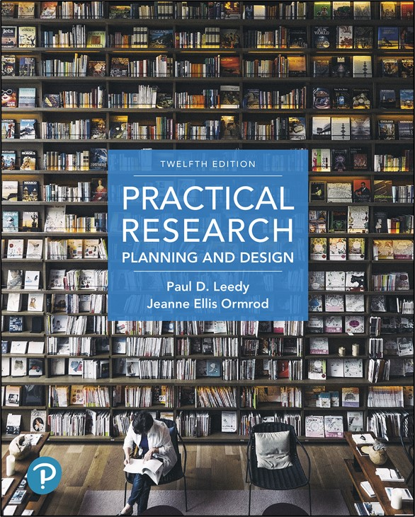
Practical Research: Planning and Design
Twelfth Edition
Chapter 3
Review of the Related Literature
Copyright © 2019, 2016, 2013 Pearson Education, Inc. All Rights Reserved
Notes:
If this PowerPoint presentation contains mathematical equations, you may need to check that your computer has the following installed:
1) Math Type Plugin
2) Math Player (free versions available)
3) NVDA Reader (free versions available)

Slide 2
Understanding the Role of the Literature Review (1 of 3)
Discover if someone has already answered your research question.
Find new ideas, perspectives, and approaches.
Learn about other researchers who conduct work in the same area.
Identify controversial issues and gaps in understanding that have not yet been resolved.

Slide 3
Understanding the Role of the Literature Review (2 of 3)
Learn how others have handled methodological and design issues in studies similar to your own.
Uncover sources of data that you may not have known existed.
Discover established measurement tools.
Interpret and make sense of your findings and tie your results to the work of those who have preceded you.
Bolster your confidence that your topic is one worth studying.

Slide 4
Understanding the Role of the Literature Review (3 of 3)
Bottom line:
The more you know about investigations and perspectives related to your topic, the more effectively you can tackle your own research problem.

Slide 5
Strategies for Locating Related Literature
Identify one or more keywords (words or short phrases summarizing your research topic) and then:
Use the library catalog and browse the holdings.
The library’s collection of academic journals, popular magazines, and newspapers are collectively known as periodicals.
Use indexes, abstracts, and other general references.
A few quick rules of thumb:
Try to use materials with recent copyright dates.
Use sources that have credibility with experts in the field.

Slide 6
Using Online Databases
Online databases are usually the preferred method to ascertain information.
PsycINFO
E R I C
Google Scholar

Slide 7
Consulting with Reference Librarians
Librarians are there to support you in your work
Consult library professionals early in your literature review process
Don’t worry! You won’t look foolish asking for help! Quite the opposite!

Slide 8
Surfing the Internet
Most are familiar with the process of using a search engine, however, consider these tips:
Use at least two keywords to limit your search
Type a plus sign (+) before any keyword you definitely want to be used in your search
To search a phrase as opposed to a single word, use quotation marks around your phrase
And remember, Wikipedia is never an authoritative source!

Slide 9
Considering Those That Have Gone before
Another important consideration is to make sure that you are considering the work of scholars that have gone before you.
We suggest tracking down sources cited by three or more authors.

Slide 10
Identify Your Sources
When you find a source, make sure you obtain enough information to provide an appropriate citation. This is important for two reasons:
You may want to track the source down later to obtain further information.
Future readers of your research may want to track your source.
For sources found on the Internet, it is good practice to record the U R L and/or the Digital Object Identifier (D O I).

Slide 11
Planning a Literature Search
When planning your research:
Write the problem in its entirety on the page or computer screen.
Write each subproblem in its entirety.
Brainstorm topics you need to learn more about.
Go to the library catalog, its online databases, and the Internet to seek out resources.

Slide 12
Use Your Library Time Efficiently (1 of 2)
Before beginning your work, consider these time saving tips:
Before you go to the library, acquire appropriate software to create a database for the resources you are going to gather.
Identify the materials you want to read and determine whether your library has them.
Develop an organized plan of attack for finding the sources you have identified.
Track down your sources.

Slide 13
Use Your Library Time Efficiently (2 of 2)
When you find a useful resource, record both (a) essential bibliographic details and (b) potentially helpful details about its contents.
Identify strategies for obtaining sources that are not immediately available.
Put a hold on a checked-out book.
Recall the book.
Submit a request for the source through interlibrary loan.
Check Google Books for older, out-of-print books.
Order books from a bookstore.
Use an online document delivery service.

Slide 14
Evaluate, Organize, Synthesize (1 of 2)
Determine for yourself whether the conclusions are justified based on the data.
Organize the ideas to address the problem.

Slide 15
Evaluate, Organize, Synthesize (2 of 2)
Synthesize what you’ve learned
Identify common themes
Show how approaches to the topic have changed over time
Compare and contrast theoretical positions
Describe general trends
Identify and explain discrepant or contradictory findings

Slide 16
Writing a Clear and Cohesive Literature Review (1 of 2)
Get the proper psychological orientation.
Know what you want to do.
Develop an organizational plan or outline.
Emphasize relatedness.
how the literature is related to the problem.
Use logical transitions.

Slide 17
Writing a Clear and Cohesive Literature Review (2 of 2)
Know the difference between describing the literature and plagiarizing it.
Always give credit where credit is due.
Minimize your use of direct quotations from other people’s writings.
Summarize what you have said.
Remember that your first draft will almost certainly NOT be your last draft.
Ask others for advice and feedback.

Slide 18

Copyright
This work is protected by United States copyright laws and is provided solely for the use of instructors in teaching their courses and assessing student learning. Dissemination or sale of any part of this work (including on the World Wide Web) will destroy the integrity of the work and is not permitted. The work and materials from it should never be made available to students except by instructors using the accompanying text in their classes. All recipients of this work are expected to abide by these restrictions and to honor the intended pedagogical purposes and the needs of other instructors who rely on these materials.

